Slide 1
Linear Arithmetics
Formal Methods Foundation
Baojian Hua
bjhua@ustc.edu.cn

Slide 2
Motivation: SAT
SAT: given a proposition P, is it satisfiable?
SAT for propositional logic:
NPC, but practically efficient
We’ve studied algorithm like DPLL
SAT for predicate logic:
Undecidable!
restrict to some specific subset: theory

Slide 3
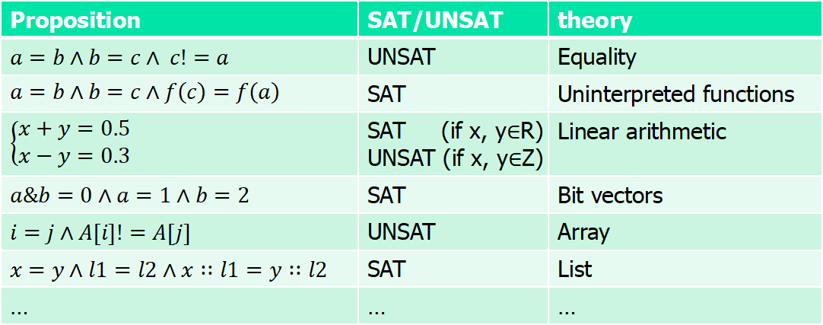
Motivation: theory
Are these satisfiable?
Proposition | SAT/UNSAT | theory
$a=b∧b=c∧ c!=a$ | UNSAT | Equality
$$a=b∧b=c∧f\left(c\right)=f\left(a\right)$$ | SAT | Uninterpreted functions
$$\left\{\begin{aligned}x+y=0.5 \\ x−y=0.3\end{aligned}\right.$$ | SAT (if x, y$∈$R) UNSAT (if x, y$∈$Z) | Linear arithmetic
$a\&b=0∧a=1∧b=2$ | SAT | Bit vectors
$i=j∧A[i]!=A[j]$ | UNSAT | Array
$x=y∧l1=l2∧x∷l1=y∷l2$ | SAT | List
… | … | …

Slide 4

Satisfiability modulo theory (SMT)
SAT
Theory
Solvers
SMT
Equality + UF
Arithmetic
Bit-vectors
…

Slide 5
Linear Arithmetic: Syntax

Slide 6
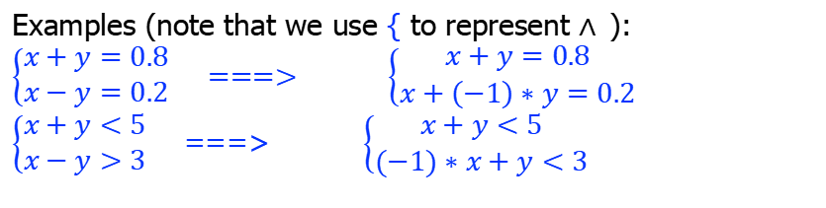
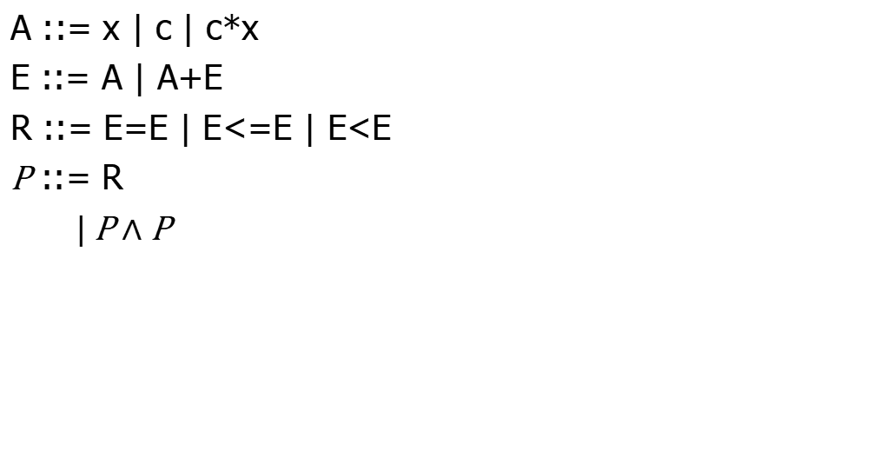
Linear arithmetic: the syntax
x: a set of variables
A ::= x | c | c*x
E ::= A | A+E
R ::= E=E | E<=E | E<E
P ::= R
$\text{|} \text{P}∧\text{P}$
Constant multiply variable. Linear?
c: a set of constants
Only addition
Only =, <=, <
Examples (note that we use { to represent $∧$):
$$\left\{\begin{aligned}x+y=0.8 \\ x−y=0.2\end{aligned}\right. ===> \left\{\begin{aligned}x+y=0.8 \\ x+\left(−1\right)∗y=0.2\end{aligned}\right.$$
$\left\{\begin{aligned}x+y<5 \\ x−y>3\end{aligned}\right.$ ===> $\left\{\begin{aligned}x+y<5 \\ (−1)∗x+y<3\end{aligned}\right.$

Slide 7
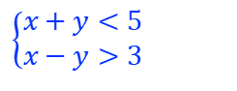
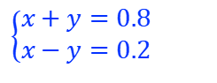
Linear arithmetic: example
$$\left\{\begin{aligned}x+y=0.8 \\ x−y=0.2\end{aligned}\right.$$
$$\left\{\begin{aligned}x+y<5 \\ x−y>3\end{aligned}\right.$$
# Z3 code:
x, y = Reals(‘x y’)
solve(x+y == 0.8,
x-y == 0.2)
# Z3 code:
x, y = Ints(‘x y’)
solve(x+y < 5,
x-y > 3)

Slide 8
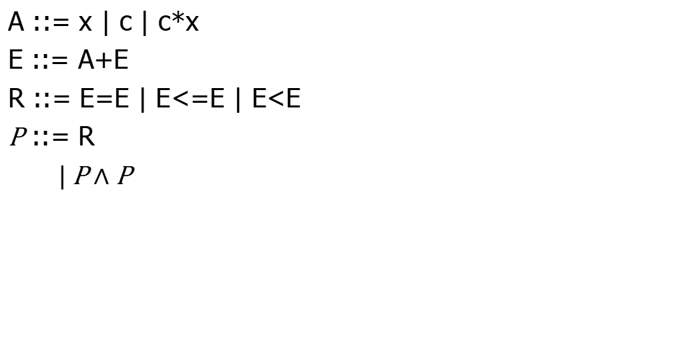

Complexity results
A ::= x | c | c*x
E ::= A+E
R ::= E=E | E<=E | E<E
P ::= R
$\text{|} \text{P}∧\text{P}$
On domain rational ($ℚ$): polynomial
On domain integer ($ℤ$): NPC
Algorithms | Fourier-Motzkin | Simplex | B&B | Omega
domain | Q | Q | Z | Z

Slide 9
Gaussian Elimination

Slide 10
Brief history
~150, The Nine Chapters on the Mathematical Art (九章算术)
although informally
1670, Newton
1810, Gauss
1950, coined as Gaussian elimination (or Guassian-Jordan elimination), GJE

Slide 11
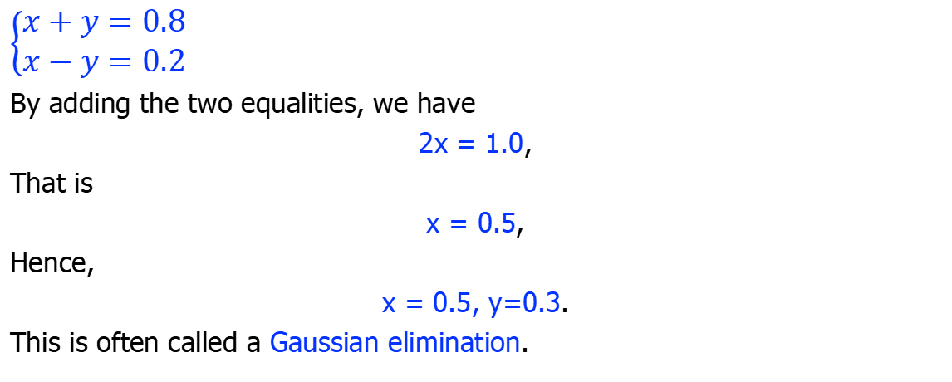
Motivation
$$\left\{\begin{aligned}x+y=0.8 \\ x−y=0.2\end{aligned}\right.$$
By adding the two equalities, we have
2x = 1.0,
That is
x = 0.5,
Hence,
x = 0.5, y=0.3.
This is often called a Gaussian elimination.

Slide 12
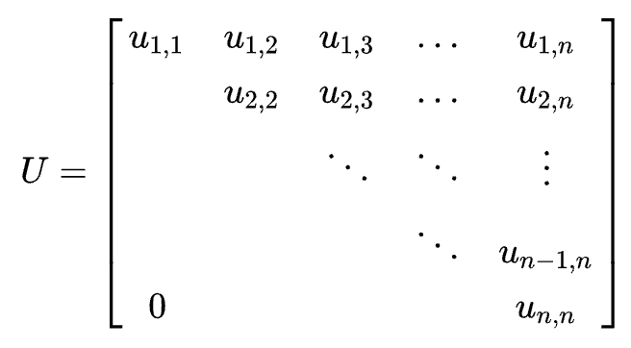
Key idea
To convert the matrix of coefficients into an upper triangular matrix
by iteratively removing variables

Slide 13
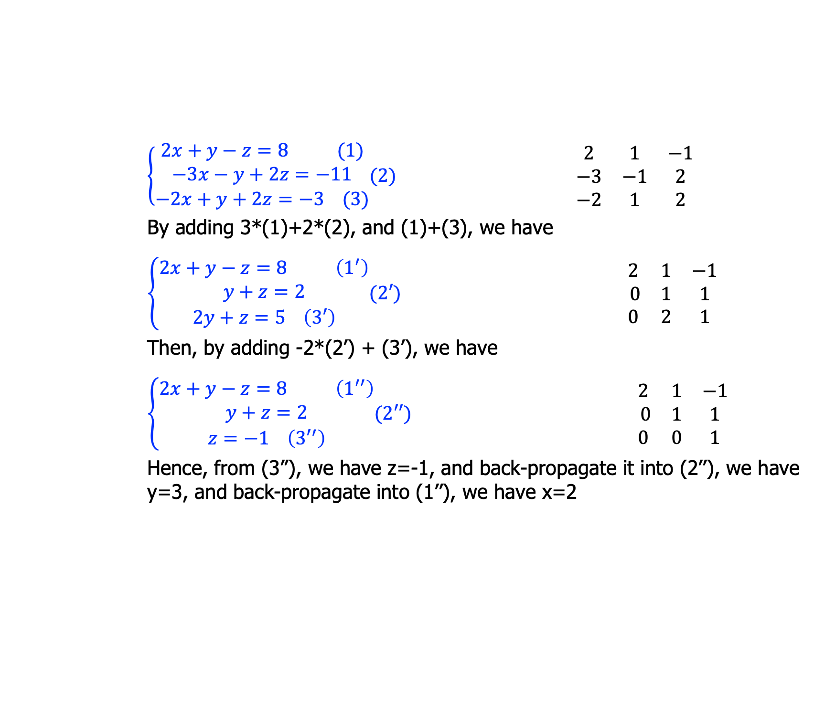
Example
$\left\{\begin{aligned}2x+y−z=8 (1) \\ −3x−y+2z=−11 \\ −2x+y+2z=−3 (3)\end{aligned}(2)\right.$ $\begin{matrix}2 & 1 & −1 \\ −3 & −1 & 2 \\ −2 & 1 & 2\end{matrix}$
By adding 3*(1)+2*(2), and (1)+(3), we have
$\left\{\begin{aligned}2x+y−z=8 \left(1^{′}\right) \\ y+z=2 \\ 2y+z=5 \left(3′\right)\end{aligned}(2′)\right.$ $\begin{matrix}2 & 1 & −1 \\ 0 & 1 & 1 \\ 0 & 2 & 1\end{matrix}$
Then, by adding -2*(2’) + (3’), we have
$\left\{\begin{aligned}2x+y−z=8 \left(1^{′′}\right) \\ y+z=2 \\ z=−1 \left({3′}^{′}\right)\end{aligned}(2′′)\right.$ $\begin{matrix}2 & 1 & −1 \\ 0 & 1 & 1 \\ 0 & 0 & 1\end{matrix}$
Hence, from (3’’), we have z=-1, and back-propagate it into (2’’), we have y=3, and back-propagate into (1’’), we have x=2

Slide 14
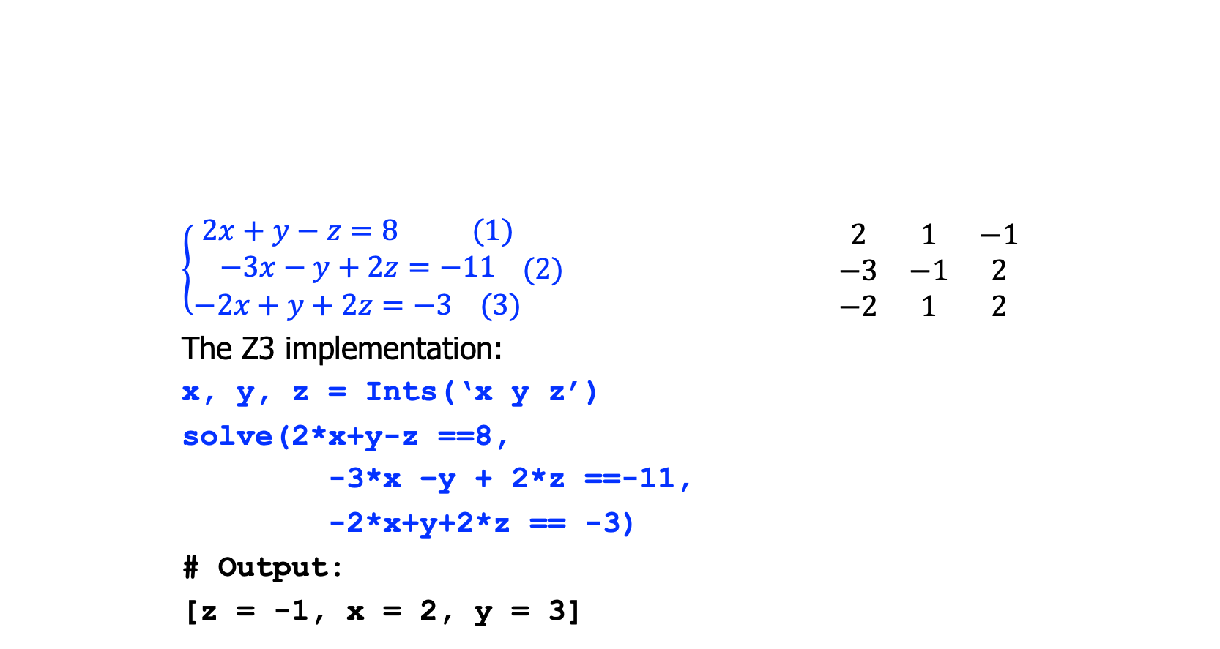
Example
$\left\{\begin{aligned}2x+y−z=8 (1) \\ −3x−y+2z=−11 \\ −2x+y+2z=−3 (3)\end{aligned}(2)\right.$ $\begin{matrix}2 & 1 & −1 \\ −3 & −1 & 2 \\ −2 & 1 & 2\end{matrix}$
The Z3 implementation:
x, y, z = Ints(‘x y z’)
solve(2*x+y-z ==8,
-3*x –y + 2*z ==-11,
-2*x+y+2*z == -3)
# Output:
[z = -1, x = 2, y = 3]

Slide 15
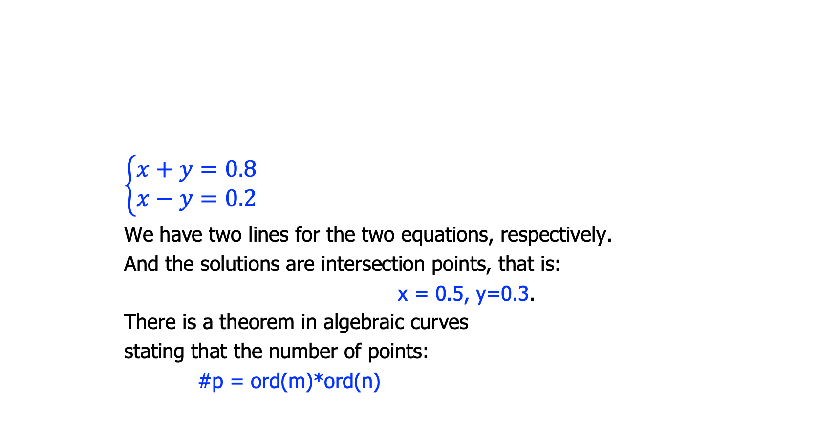
Geometry Perspective
$$\left\{\begin{aligned}x+y=0.8 \\ x−y=0.2\end{aligned}\right.$$
We have two lines for the two equations, respectively.
And the solutions are intersection points, that is:
x = 0.5, y=0.3.
There is a theorem in algebraic curves
stating that the number of points:
#p = ord(m)*ord(n)
(0.5, 0.3)

Slide 16
Complexity
The complexity is O(n³), for n-element matrix
While efficient for small matrix, may be slow for large matrix with millions of elements
many practical improvements

Slide 17
Fourier-Motzkin Elimination

Slide 18
Fourier-Motzkin variable elimination (FME)
Key idea:
Repeatedly eliminate variables, until obtain SAT or UNSAT
Not as efficient as other algorithms
because of expression explosion
but still practical for small number of variables

Slide 19
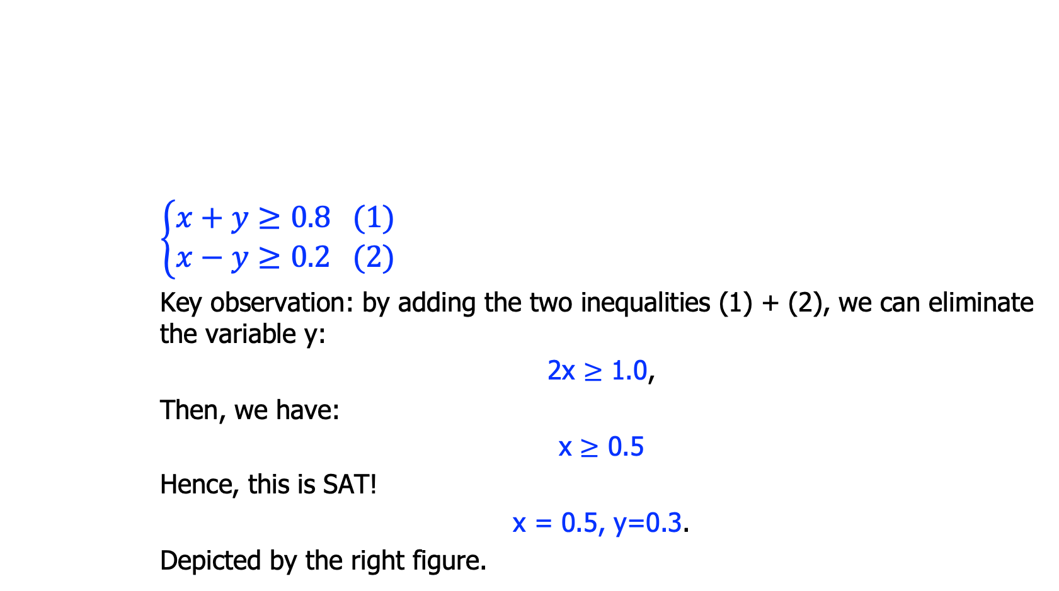
Motivation: solving inequality
$$\left\{\begin{aligned}x+y≥0.8 (1) \\ x−y≥0.2 (2)\end{aligned}\right.$$
Key observation: by adding the two inequalities (1) + (2), we can eliminate the variable y:
2x $≥$ 1.0,
Then, we have:
x $≥$ 0.5
Hence, this is SAT!
x = 0.5, y=0.3.
Depicted by the right figure.
(0.5, 0.3)

Slide 20
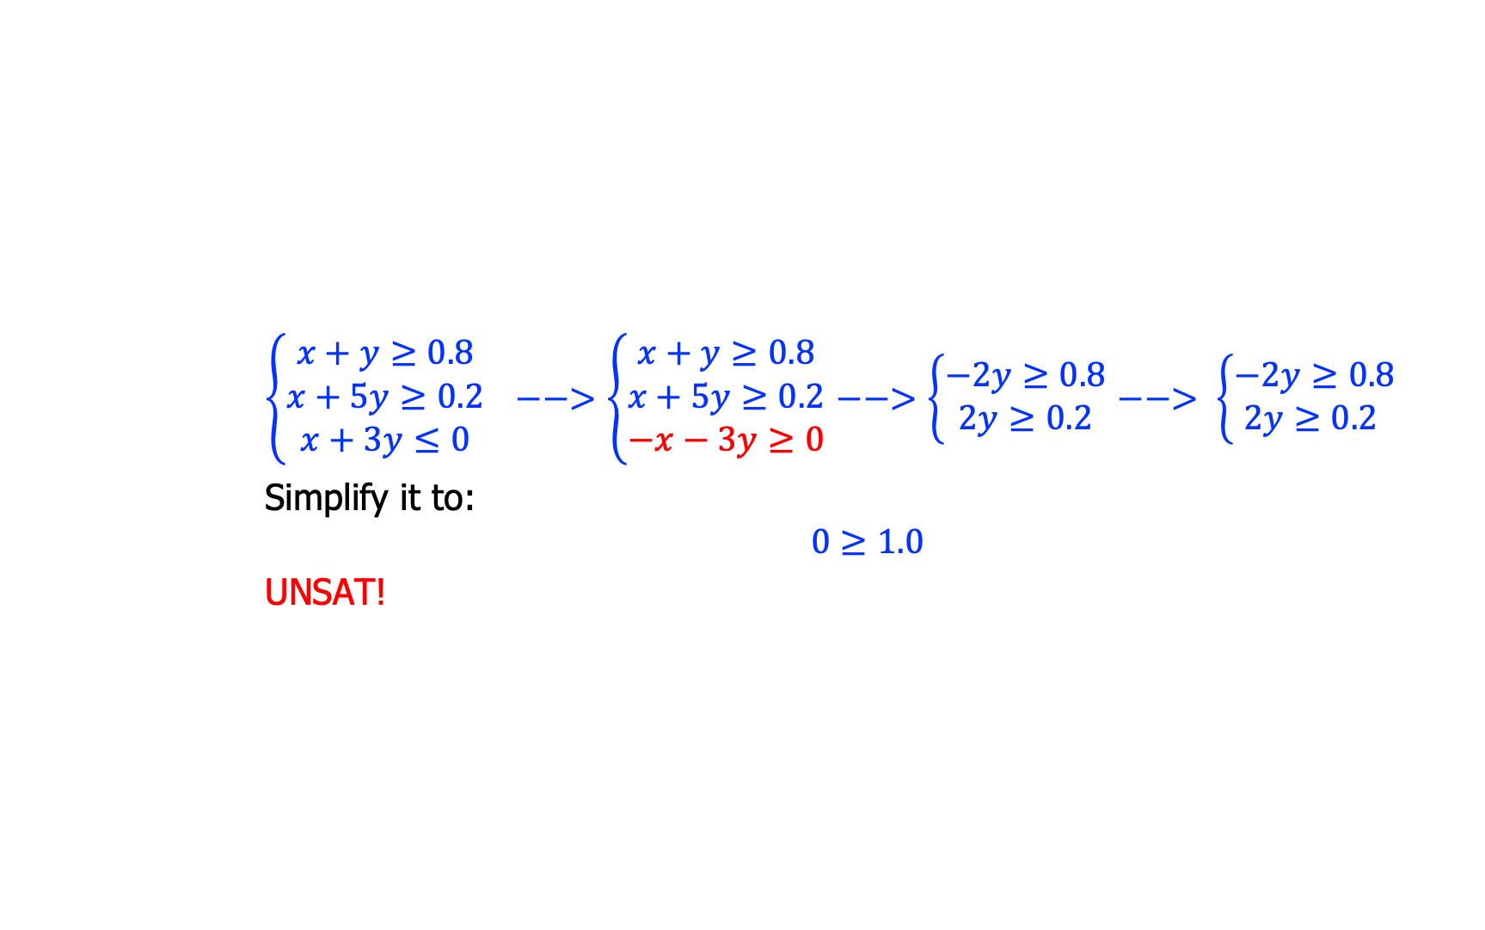
Motivation: solving inequality
adjust the direction
pairwise
addition
pairwise
addition
$\left\{\begin{aligned}x+y≥0.8 \\ x+5y≥0.2 \\ x+3y≤0\end{aligned}\right. −−>\left\{\begin{aligned}x+y≥0.8 \\ x+5y≥0.2 \\ −x−3y≥0\end{aligned}\right.$ $−−>\left\{\begin{aligned}−2y≥0.8 \\ 2y≥0.2\end{aligned}\right.$ $−−> \left\{\begin{aligned}−2y≥0.8 \\ 2y≥0.2 \end{aligned}\right.$
Simplify it to:
$$0≥1.0$$
UNSAT!

Slide 21
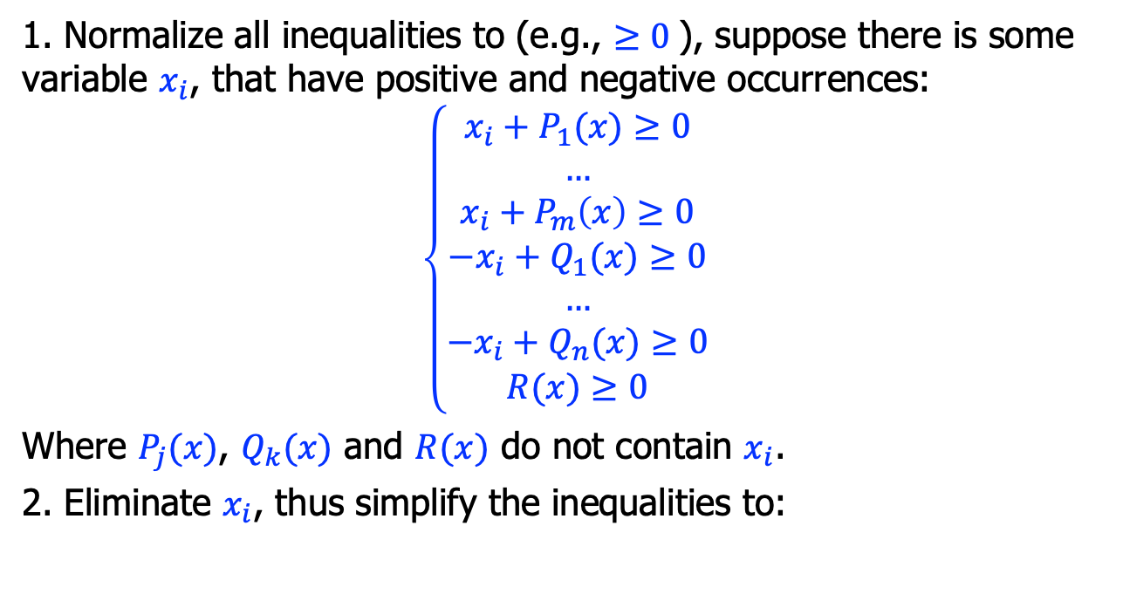
Algorithm
1. Normalize all inequalities to (e.g., $≥0$), suppose there is some variable $x_{i}$, that have positive and negative occurrences:
$$\left\{\begin{aligned}x_{i}+P_{1}(x)≥0 \\ … \\ x_{i}+P_{m}\left(x\right)≥0 \\ −x_{i}+Q_{1}(x)≥0 \\ … \\ −x_{i}+Q_{n}(x)≥0 \\ R(x)≥0\end{aligned}\right.$$
Where $P_{j}(x)$, $Q_{k}(x)$ and $R(x)$ do not contain $x_{i}$.
2. Eliminate $x_{i}$, thus simplify the inequalities to:

Slide 22
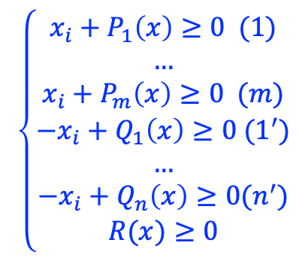
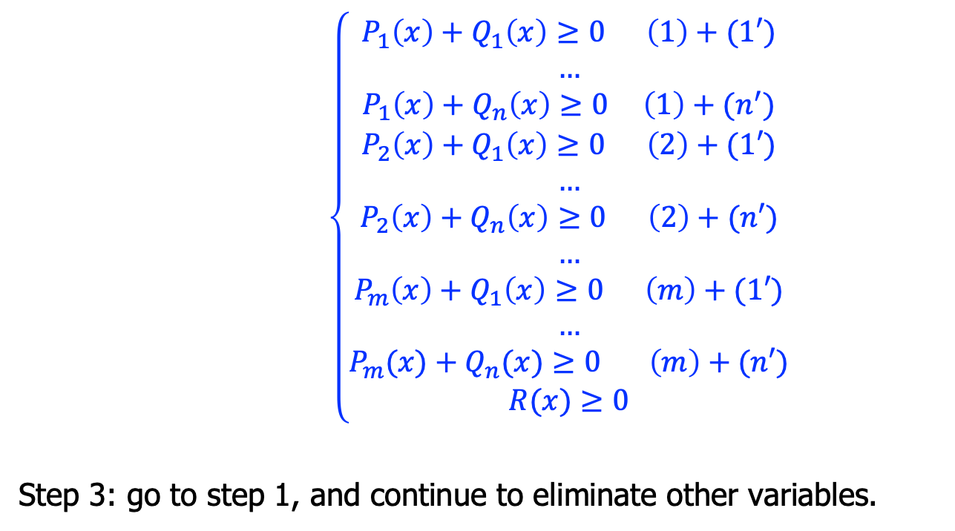
Algorithm, cont’
$\left\{\begin{aligned}P_{1}\left(x\right)+Q_{1}\left(x\right)≥0 \left(1\right)+(1′) \\ … \\ P_{1}\left(x\right)+Q_{n}\left(x\right)≥0 \left(1\right)+(n^{′}) \\ P_{2}\left(x\right)+Q_{1}\left(x\right)≥0 \left(2\right)+(1′) \\ … \\ P_{2}\left(x\right)+Q_{n}\left(x\right)≥0 \left(2\right)+(n′) \\ … \\ P_{m}\left(x\right)+Q_{1}\left(x\right)≥0 \left(m\right)+(1′) \\ … \\ P_{m}(x{)+Q}_{n}(x)≥0 \left(m\right)+(n′) \\ R(x)≥0\end{aligned}\right.$
Step 3: go to step 1, and continue to eliminate other variables.
$$\left\{\begin{aligned}x_{i}+P_{1}\left(x\right)≥0 (1) \\ … \\ x_{i}+P_{m}\left(x\right)≥0 (m) \\ −x_{i}+Q_{1}\left(x\right)≥0 (1^{′}) \\ … \\ −x_{i}+Q_{n}\left(x\right)≥0(n^{′}) \\ R(x)≥0\end{aligned}\right.$$

Slide 23
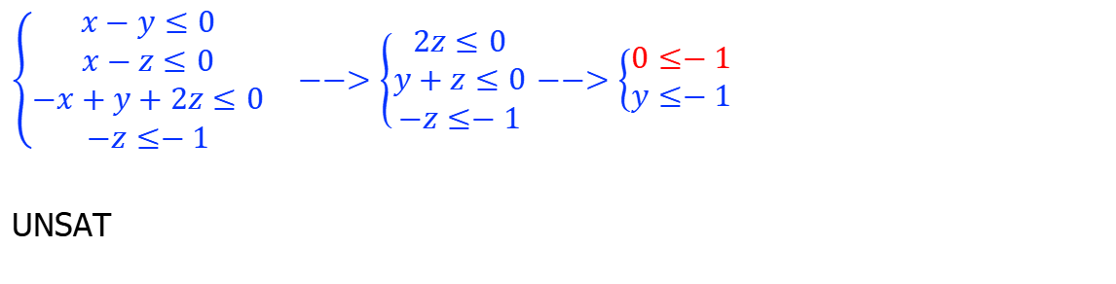
Example
$\left\{\begin{aligned}x−y≤0 \\ x−z≤0 \\ −x+y+2z≤0 \\ −z≤−1\end{aligned}\right. −−>\left\{\begin{aligned}2z≤0 \\ y+z≤0 \\ −z≤−1\end{aligned}\right.$ $−−>\left\{\begin{aligned}0≤−1 \\ y≤−1\end{aligned}\right.$
UNSAT

Slide 24
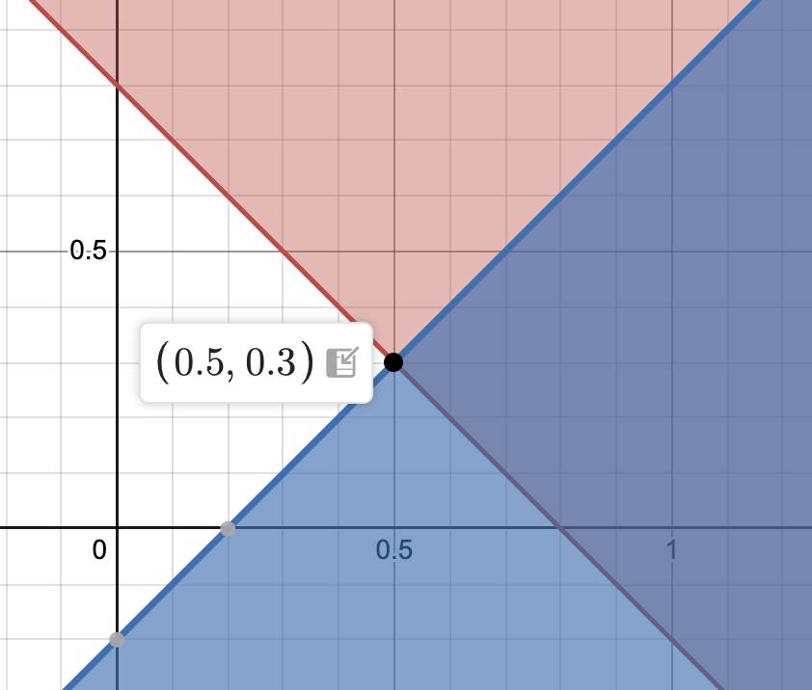
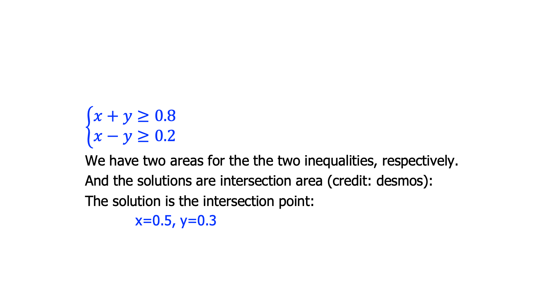
Geometry Perspective
$$\left\{\begin{aligned}x+y≥0.8 \\ x−y≥0.2\end{aligned}\right.$$
We have two areas for the the two inequalities, respectively.
And the solutions are intersection area (credit: desmos):
The solution is the intersection point:
x=0.5, y=0.3

Slide 25
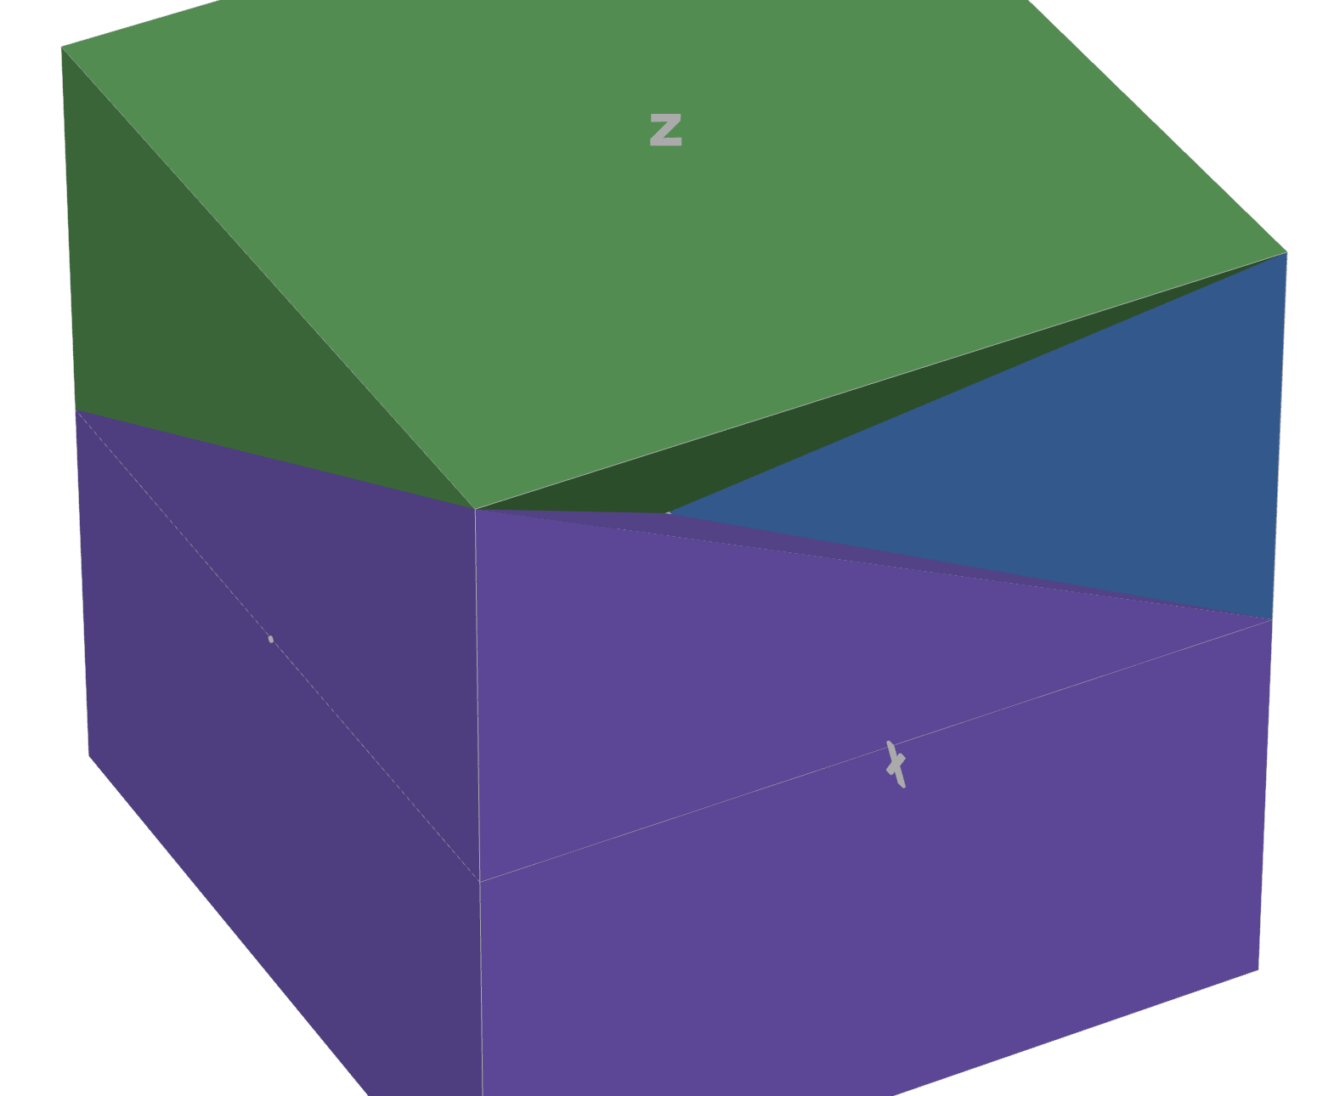
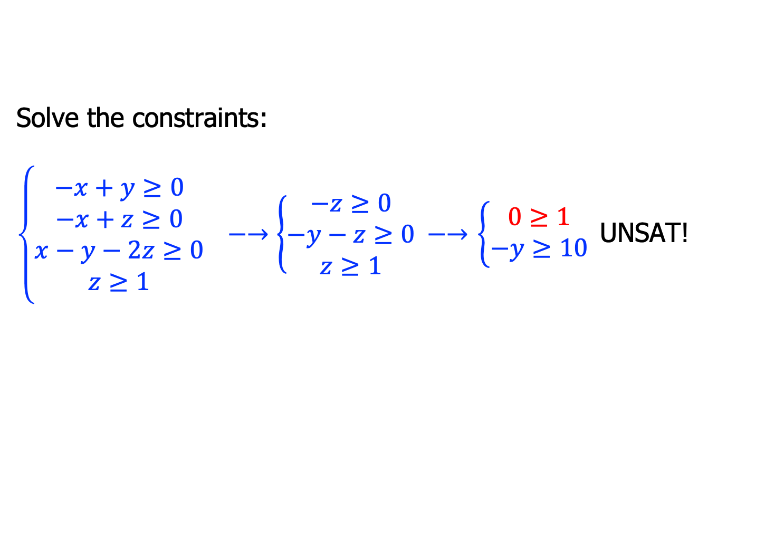
Example
Solve the constraints:
$\left\{\begin{aligned}−x+y≥0 \\ −x+z≥0 \\ x−y−2z≥0 \\ z≥1\end{aligned}\right. −→\left\{\begin{aligned}−z≥0 \\ −y−z≥0 \\ z≥1 \end{aligned}−→\right.$ $\left\{\begin{aligned}0≥1 \\ −y≥10 \end{aligned}\right.$UNSAT!

Slide 26
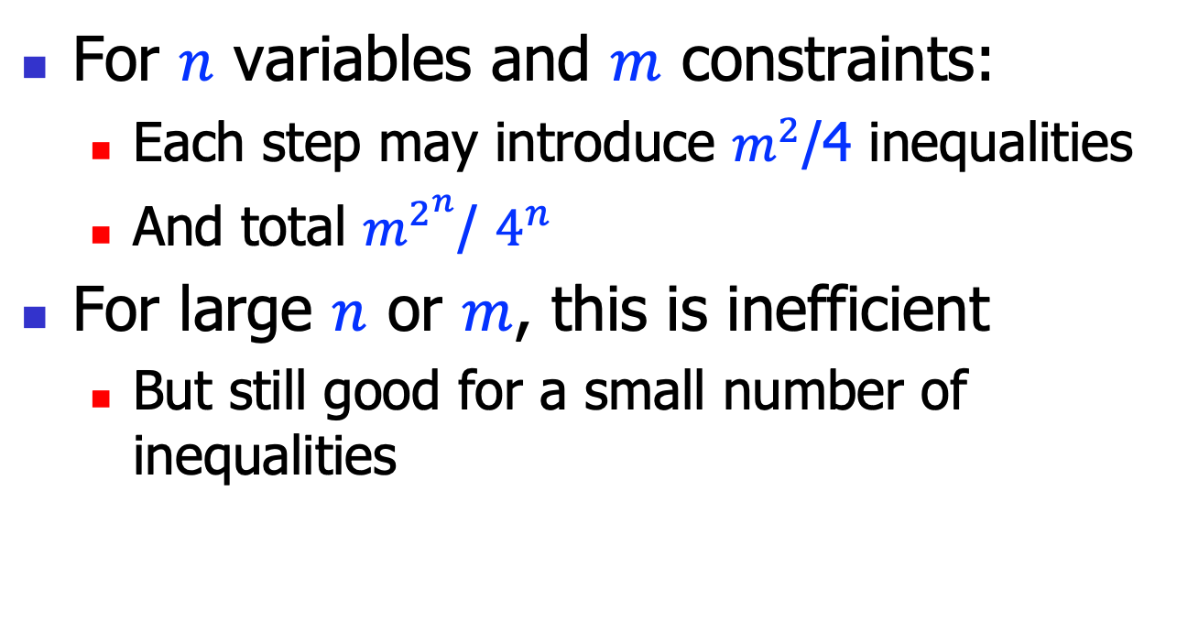
Complexity
For $n$ variables and $m$ constraints:
Each step may introduce $m^{2}$/4 inequalities
And total $m^{2^{n}}$/ $4^{n}$
For large $n$ or $m$, this is inefficient
But still good for a small number of inequalities

Slide 27
Non-linear Arithmetic

Slide 28
Non-linear Arithmetic
Expressions with the power of >=2:
E.g. (conic sections):
x²+y²=1 (circle)
x²/4+y²/2=1 (ellipse)
x²/4-y²/2=1 (hyperbola)
y²=4x (parabola)
E.g.(elliptic curves):
y³ = x²-x+1

Slide 29
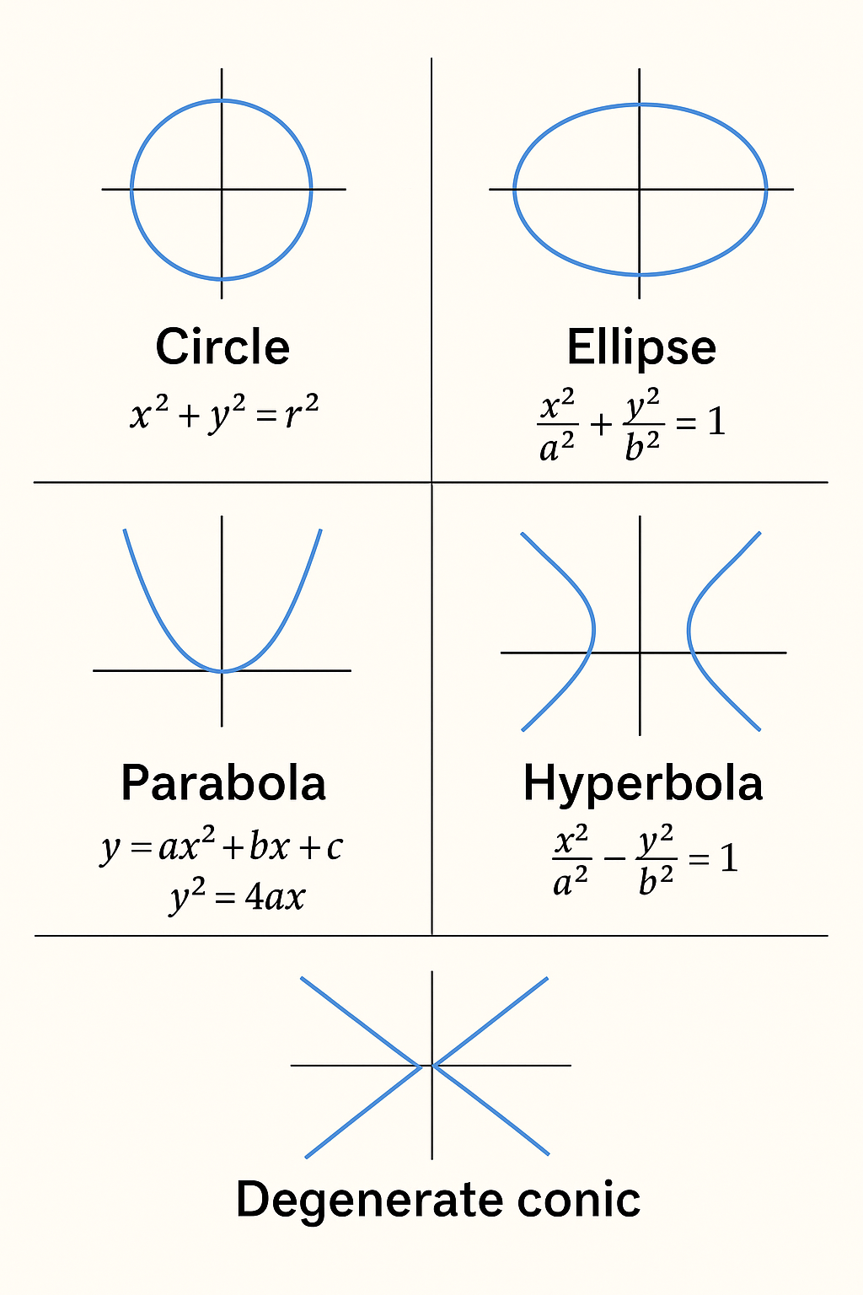
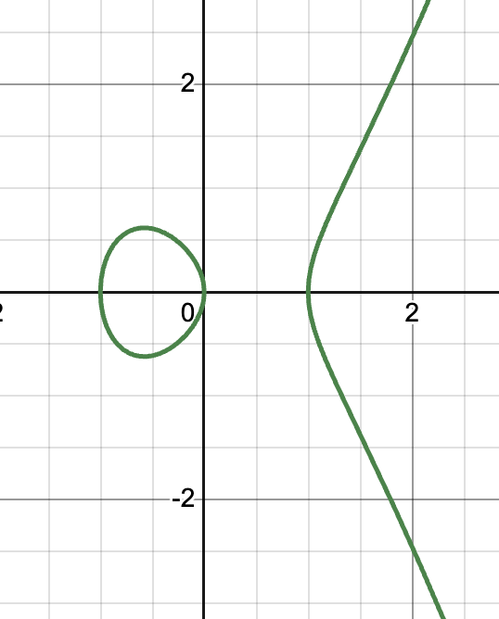
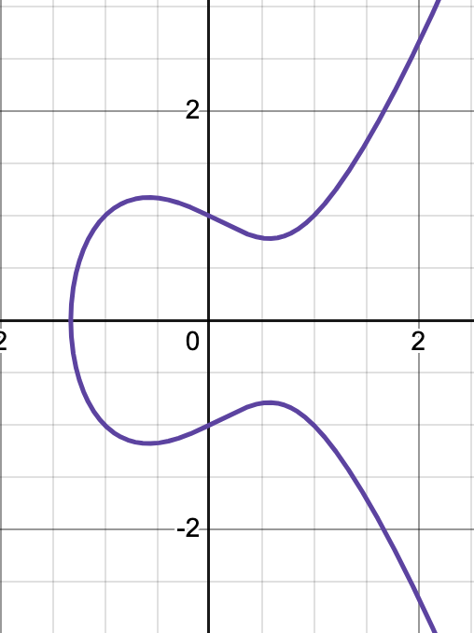
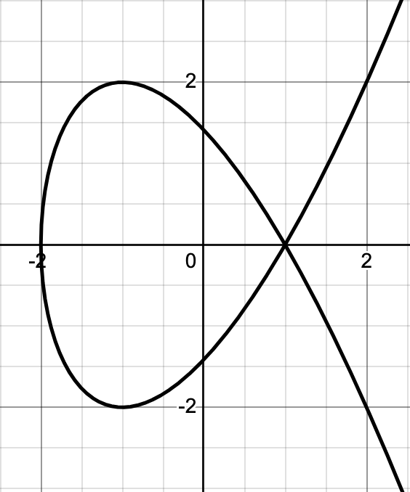
Geometry Perspective
y²=x³-x
y²=x³-x+1
y²=x³-3x+2
Elliptic curves are widely used in many fields including number theory, physics, and cryptography (ECC).

Slide 30
Solving Non-linear Arithmetic
Undecidable in general
for equations with degree>=5, no algebraic solutions
But solvers like Z3 often have incomplete algorithms
i.e., may generate outputs as well as timeout or loops
see the handout “non_linear.py” for sample code

Slide 31
Linear Programming

Slide 32
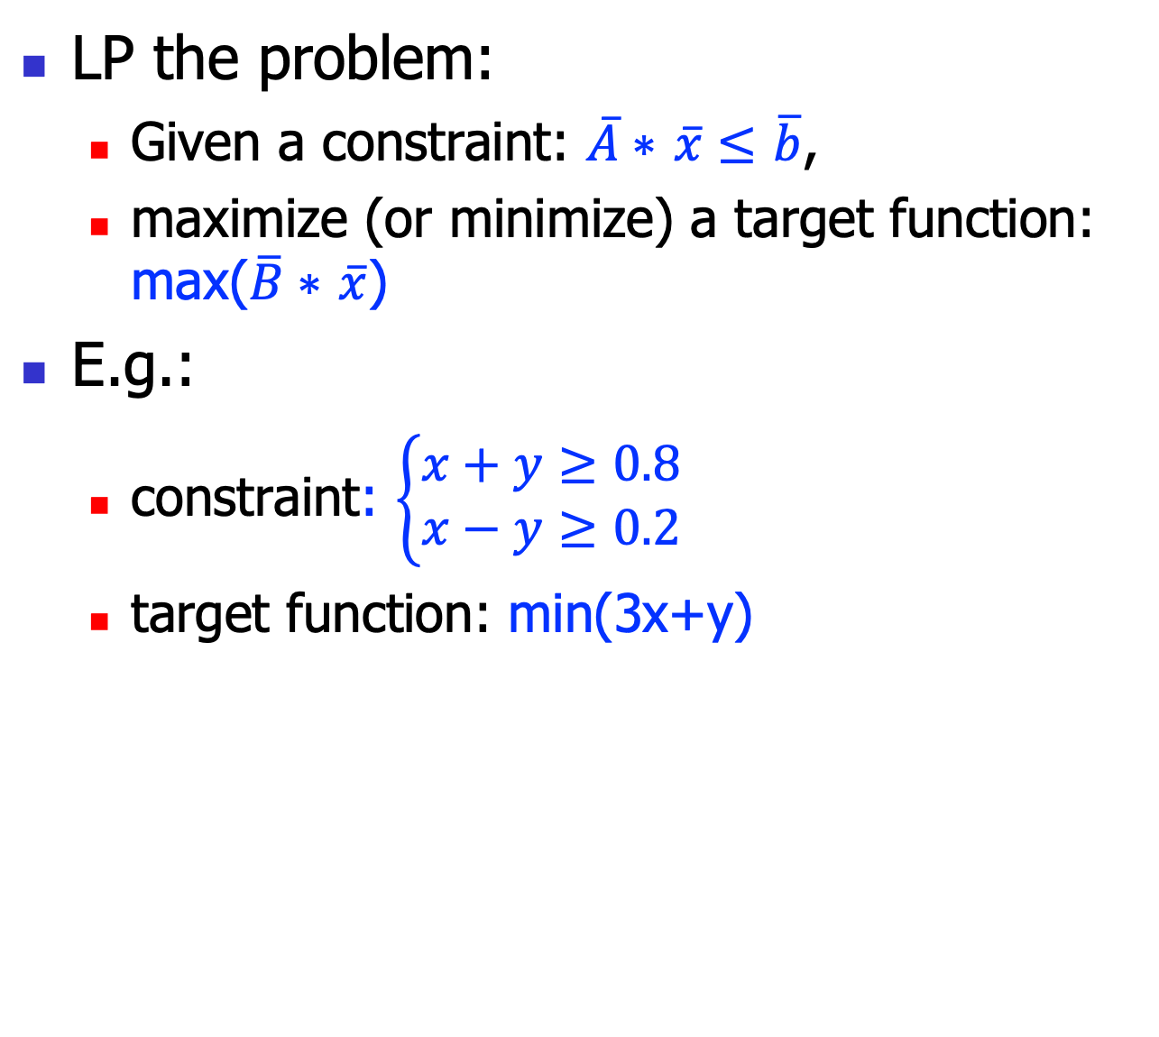
Linear Programming
LP the problem:
Given a constraint: $\overline{A}∗$ $\overline{x}≤$ $\overline{b}$,
maximize (or minimize) a target function: max($\overline{B}∗$ $\overline{x}$)
E.g.:
constraint: $\left\{\begin{aligned}x+y≥0.8 \\ x−y≥0.2\end{aligned}\right.$
target function: min(3x+y)

Slide 33
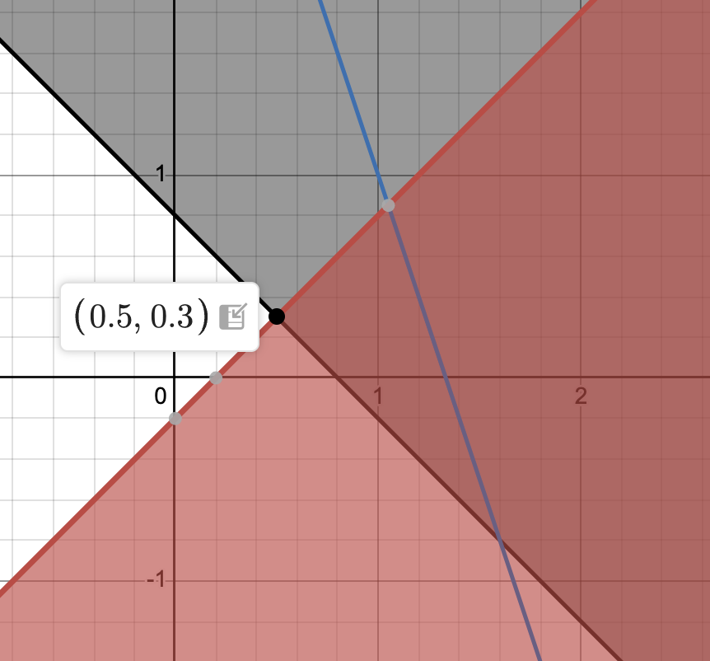
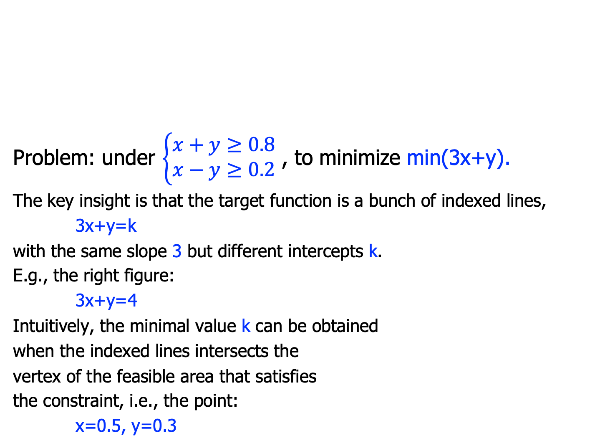
Geometry Intuition
Problem: under $\left\{\begin{aligned}x+y≥0.8 \\ x−y≥0.2\end{aligned}\right.$ , to minimize min(3x+y).
The key insight is that the target function is a bunch of indexed lines,
3x+y=k
with the same slope 3 but different intercepts k.
E.g., the right figure:
3x+y=4
Intuitively, the minimal value k can be obtained
when the indexed lines intersects the
vertex of the feasible area that satisfies
the constraint, i.e., the point:
x=0.5, y=0.3

Slide 34
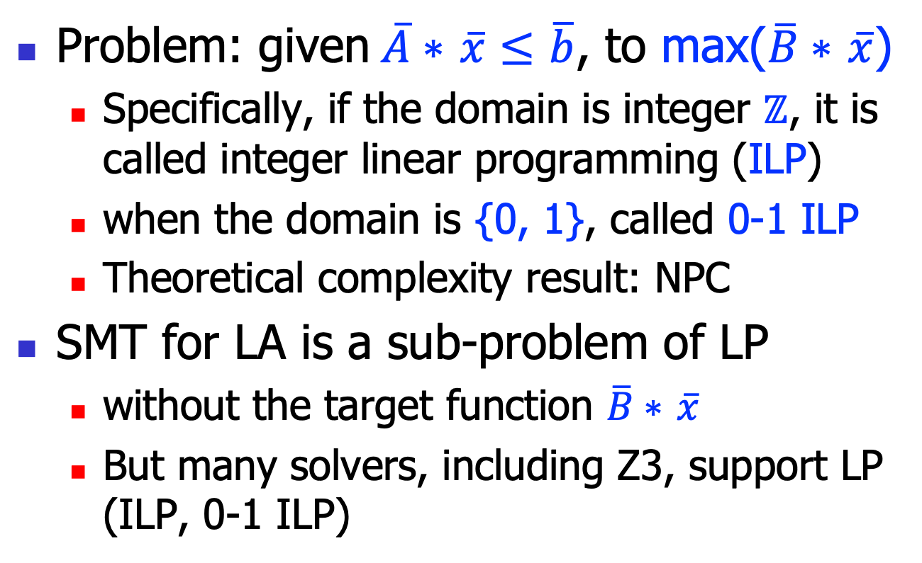
Linear Programming
Problem: given$\overline{A}∗$ $\overline{x}≤$ $\overline{b}$, to max($\overline{B}∗$ $\overline{x}$)
Specifically, if the domain is integer $ℤ$, it is called integer linear programming (ILP)
when the domain is {0, 1}, called 0-1 ILP
Theoretical complexity result: NPC
SMT for LA is a sub-problem of LP
without the target function $\overline{B}∗$ $\overline{x}$
But many solvers, including Z3, support LP (ILP, 0-1 ILP)

Slide 35
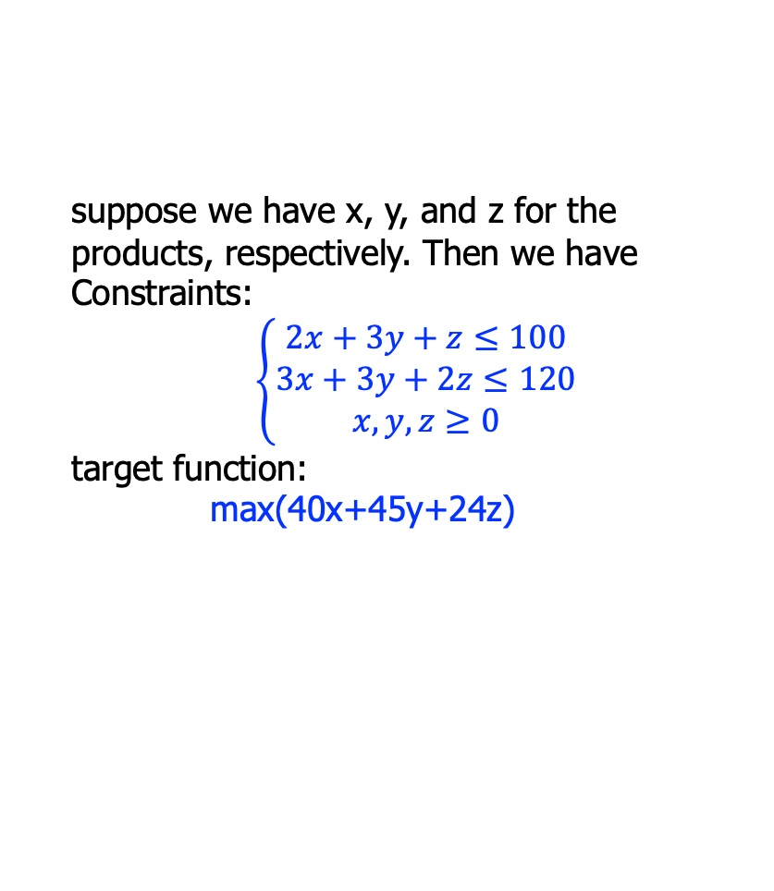
Brief History
LP originated during 1930~50’
Driven by the need of World War II
E.g.: a factory makes 3 products P1, P2, and P3 from 2 ingredients i1 and i2, how to maximize the #value? (i1=100, i2=120)
suppose we have x, y, and z for the products, respectively. Then we have
Constraints:
$$\left\{\begin{aligned}2x+3y+z≤100 \\ 3x+3y+2z≤120 \\ x, y, z≥0\end{aligned}\right.$$
target function:
max(40x+45y+24z)
Product/ Ingredient | P1 | P2 | P3
i1 | 2 | 3 | 1
i2 | 3 | 3 | 2
#value | 40 | 45 | 24
x
y
z

Slide 36
Brief History
Simplex method(单纯形法), George Dantzig, 1947
exponential theoretically
Ellipsoid method(椭球法), Leonid Khachiyan, 1979
also proved that LP belongs to P
Interior Point Methods(内点法), Karmarkar, 1984
An important field of operational research(运筹学)
And has deep connection with other fields like graph theory and convex optimizations(凸优化)

Slide 37
Simplex

Slide 38
Motivation
The optimal solutions is on the vertex of the feasible region:
We can crawl through these candidate vertices to determine the target

Slide 39
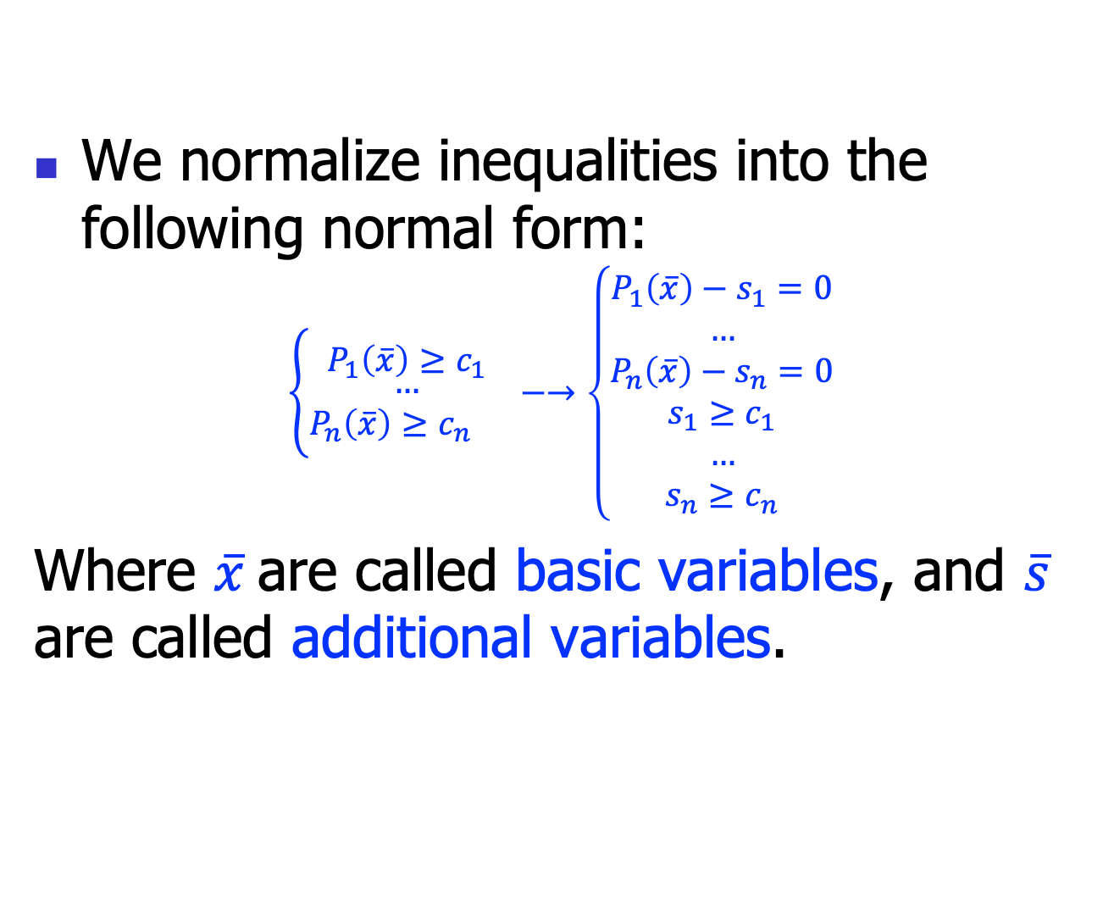
Normal forms
We normalize inequalities into the following normal form:
$$\left\{\begin{aligned}P_{1}\left(\overline{x}\right)≥c_{1} \\ \begin{aligned} … \\ P_{n}\left(\overline{x}\right)≥c_{n} \end{aligned}\end{aligned}\right. −→\left\{\begin{aligned}P_{1}\left(\overline{x}\right)−s_{1}=0 \\ … \\ P_{n}\left(\overline{x}\right)−s_{n}=0 \\ s_{1}≥c_{1} \\ … \\ s_{n}≥c_{n}\end{aligned}\right.$$
Where $\overline{x}$are called basic variables, and $\overline{s}$ are called additional variables.

Slide 40
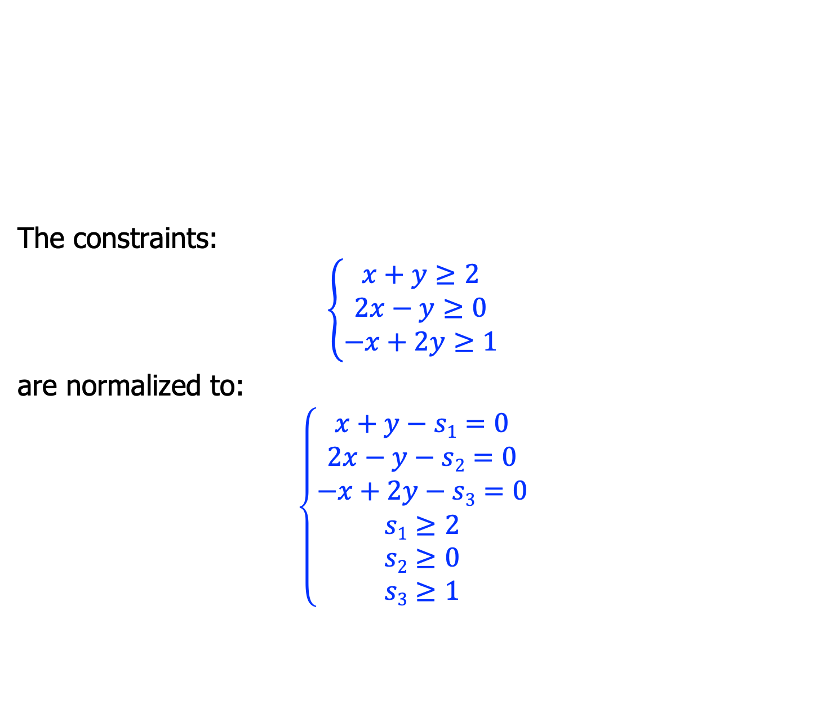
Example
The constraints:
$$\left\{\begin{aligned}x+y≥2 \\ 2x−y≥0 \\ −x+2y≥1\end{aligned}\right.$$
are normalized to:
$$\left\{\begin{aligned}x+y−s1=0 \\ 2x−y−s2=0 \\ −x+2y−s3=0 \\ s1≥2 \\ s2≥0 \\ s3≥1\end{aligned}\right.$$

Slide 41
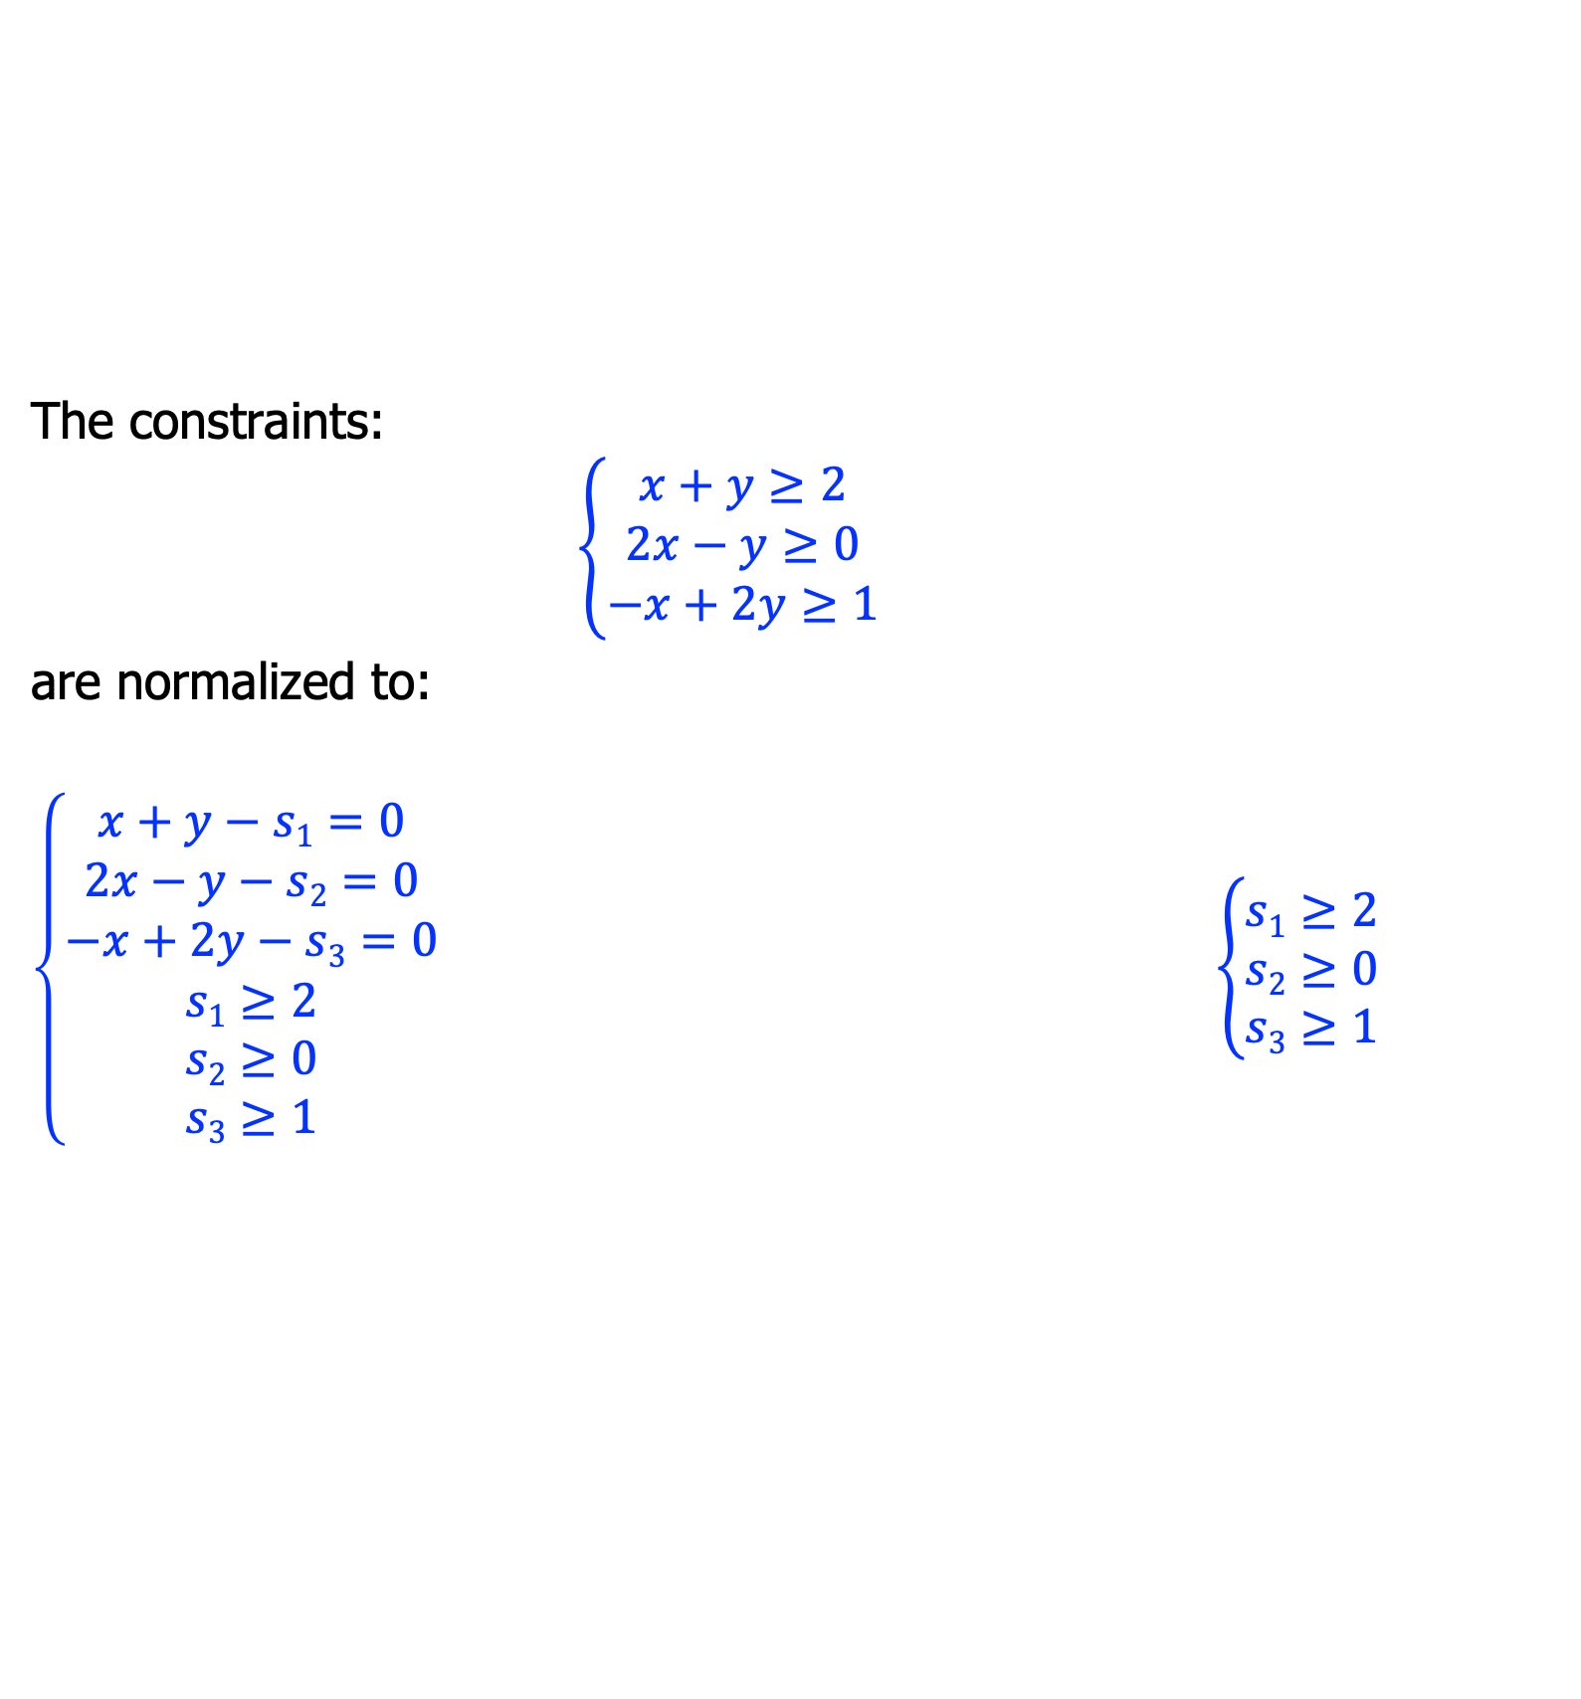
Tableau
The constraints:
$$\left\{\begin{aligned}x+y≥2 \\ 2x−y≥0 \\ −x+2y≥1\end{aligned}\right.$$
are normalized to:
$\left\{\begin{aligned}x+y−s1=0 \\ 2x−y−s2=0 \\ −x+2y−s3=0 \\ s1≥2 \\ s2≥0 \\ s3≥1\end{aligned}\right.$ $\left\{\begin{aligned}s1≥2 \\ s2≥0 \\ s3≥1\end{aligned}\right.$
 | x | y
s₁ | 1 | 1
s₂ | 2 | -1
s₃ | -1 | 2

Slide 42
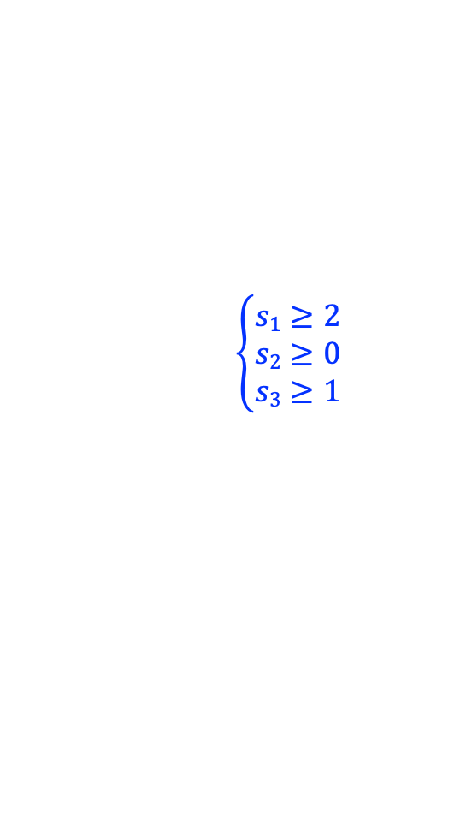
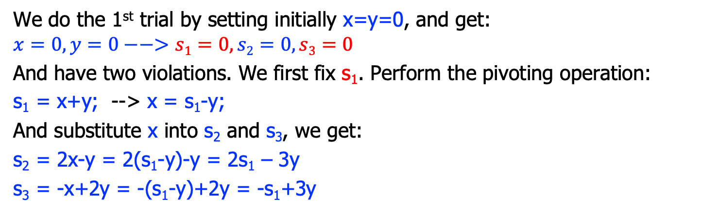
Trial and fix
 | x | y
s₁ | 1 | 1
s₂ | 2 | -1
s₃ | -1 | 2
$$\left\{\begin{aligned}s1≥2 \\ s2≥0 \\ s3≥1\end{aligned}\right.$$
We do the 1st trial by setting initially x=y=0, and get:
$$x=0, y=0−−>s1=0, s2=0, s3=0$$
And have two violations. We first fix s₁. Perform the pivoting operation:
s₁ = x+y; --> x = s₁-y;
And substitute x into s₂ and s₃, we get:
s₂ = 2x-y = 2(s₁-y)-y = 2s₁ – 3y
s₃ = -x+2y = -(s₁-y)+2y = -s₁+3y
 | s1 | y
x | 1 | -1
s₂ | 2 | -3
s₃ | -1 | 3

Slide 43
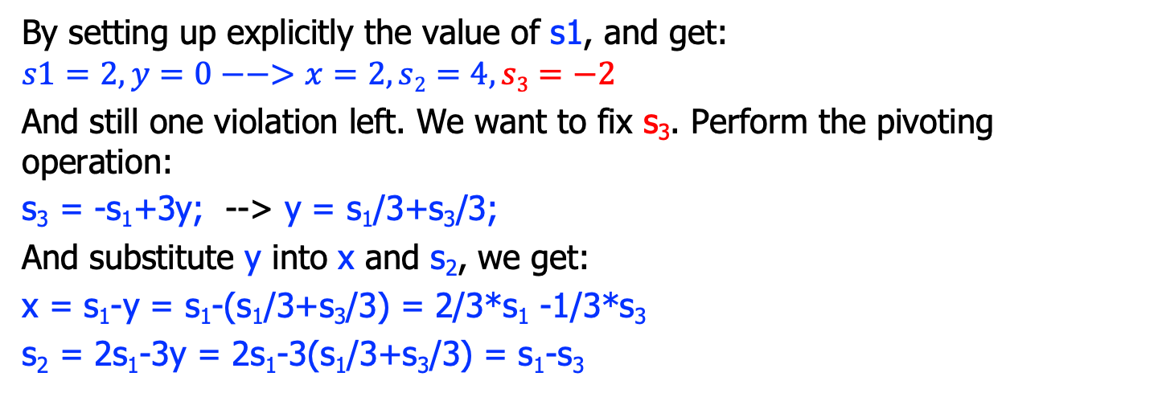
Trial and fix
 | s1 | y
x | 1 | -1
s₂ | 2 | -3
s₃ | -1 | 3
$$\left\{\begin{aligned}s1≥2 \\ s2≥0 \\ s3≥1\end{aligned}\right.$$
By setting up explicitly the value of s1, and get:
$$s1=2,y=0−−>x=2, s2=4, s3=−2$$
And still one violation left. We want to fix s₃. Perform the pivoting operation:
s₃ = -s₁+3y; --> y = s₁/3+s₃/3;
And substitute y into x and s₂, we get:
x = s₁-y = s₁-(s₁/3+s₃/3) = 2/3*s₁ -1/3*s₃
s₂ = 2s₁-3y = 2s₁-3(s₁/3+s₃/3) = s₁-s₃
 | s₁ | s₃
x | 2/3 | -1/3
s₂ | 1 | -1
y | 1/3 | 1/3

Slide 44
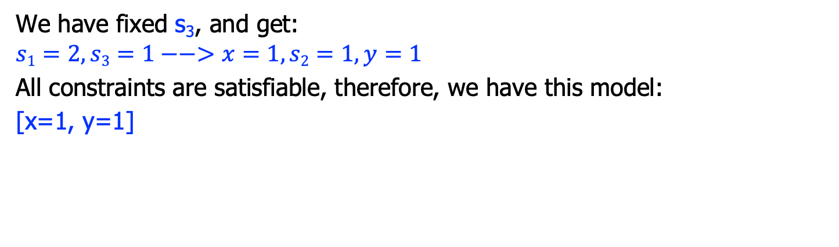
Trial and fix
 | s₁ | s₃
x | 2/3 | -1/3
s₂ | 1 | -1
y | 1/3 | 1/3
$$\left\{\begin{aligned}s1≥2 \\ s2≥0 \\ s3≥1\end{aligned}\right.$$
We have fixed s₃, and get:
$$s1=2,s3=1−−>x=1, s2=1, y=1$$
All constraints are satisfiable, therefore, we have this model:
[x=1, y=1]

Slide 45
Simplex algorithm
simplex(){
tab = constructTableau();
for(each additional variable s_{i}){
if(s_{i} violates its constraint){
if(there is a suitable x_{j})
pivot(s_{i}, x_{j});
else return UNSAT;
}
}
return SAT;
}

Slide 46
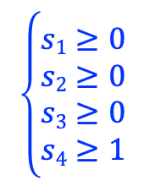
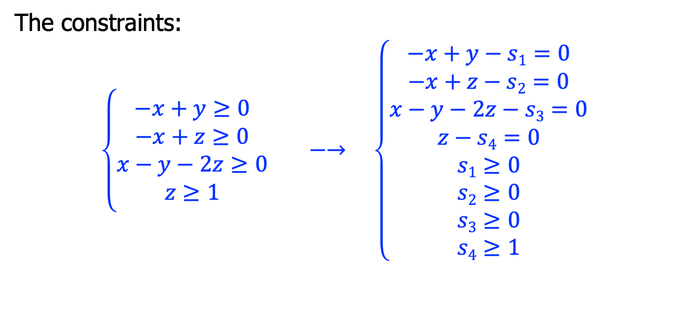
Another Example
The constraints:
$$\left\{\begin{aligned}−x+y≥0 \\ −x+z≥0 \\ x−y−2z≥0 \\ z≥1\end{aligned}\right. −→ \left\{\begin{aligned}−x+y−s1=0 \\ −x+z−s2=0 \\ x−y−2z−s3=0 \\ z−s4=0 \\ s1≥0 \\ s2≥0 \\ s3≥0 \\ s4≥1\end{aligned}\right.$$
 | x | y | z
s₁ | -1 | 1 | 0
s₂ | -1 | 0 | 1
s₃ | 1 | -1 | -2
s₄ | 0 | 0 | 1
$$\left\{\begin{aligned}s1≥0 \\ s2≥0 \\ s3≥0 \\ s4≥1\end{aligned}\right.$$

Slide 47

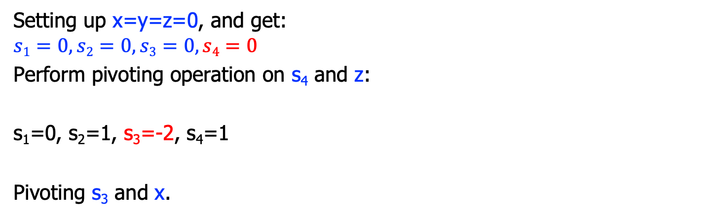
Tableau
 | x | y | z
s₁ | -1 | 1 | 0
s₂ | -1 | 0 | 1
s₃ | 1 | -1 | -2
s₄ | 0 | 0 | 1
$$\left\{\begin{aligned}s1≥0 \\ s2≥0 \\ s3≥0 \\ s4≥1\end{aligned}\right.$$
Setting up x=y=z=0, and get:
$$s1=0,s2=0,s3=0,s4=0$$
Perform pivoting operation on s₄ and z:
s₁=0, s₂=1, s₃=-2, s₄=1
Pivoting s₃ and x.
 | x | y | s₄
s₁ | -1 | 1 | 0
s₂ | -1 | 0 | 1
s₃ | 1 | -1 | -2
z | 0 | 0 | 1

Slide 48
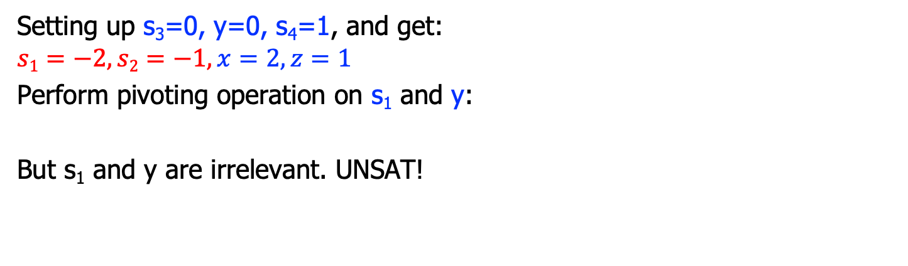
Tableau
 | s₃ | y | s₄
s₁ | -1 | 0 | -2
s₂ | -1 | -1 | -1
x | 1 | 1 | 2
z | 0 | 0 | 1
$$\left\{\begin{aligned}s1≥0 \\ s2≥0 \\ s3≥0 \\ s4≥1\end{aligned}\right.$$
Setting up s₃=0, y=0, s₄=1, and get:
$$s1=−2, s2=−1,x=2,z=1$$
Perform pivoting operation on s₁ and y:
But s₁ and y are irrelevant. UNSAT!
 | s₃ | s₁ | s₄
y | -1 | 1 | 0
s₂ | -1 | 0 | 1
s₃ | 1 | -1 | -2
z | 0 | 0 | 1

Slide 49
Branch & Bound

Slide 50
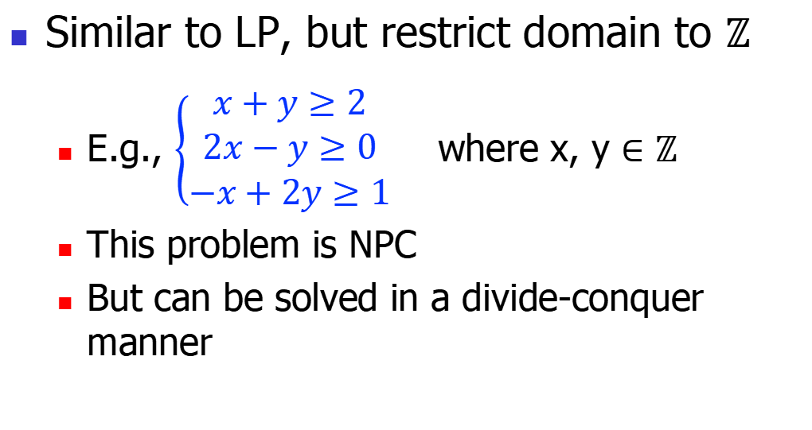
ILP
Similar to LP, but restrict domain to $ℤ$
E.g., $\left\{\begin{aligned}x+y≥2 \\ 2x−y≥0 \\ −x+2y≥1\end{aligned}\right.$ where x, y $∈ℤ$
This problem is NPC
But can be solved in a divide-conquer manner

Slide 51
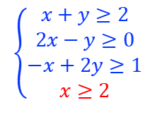
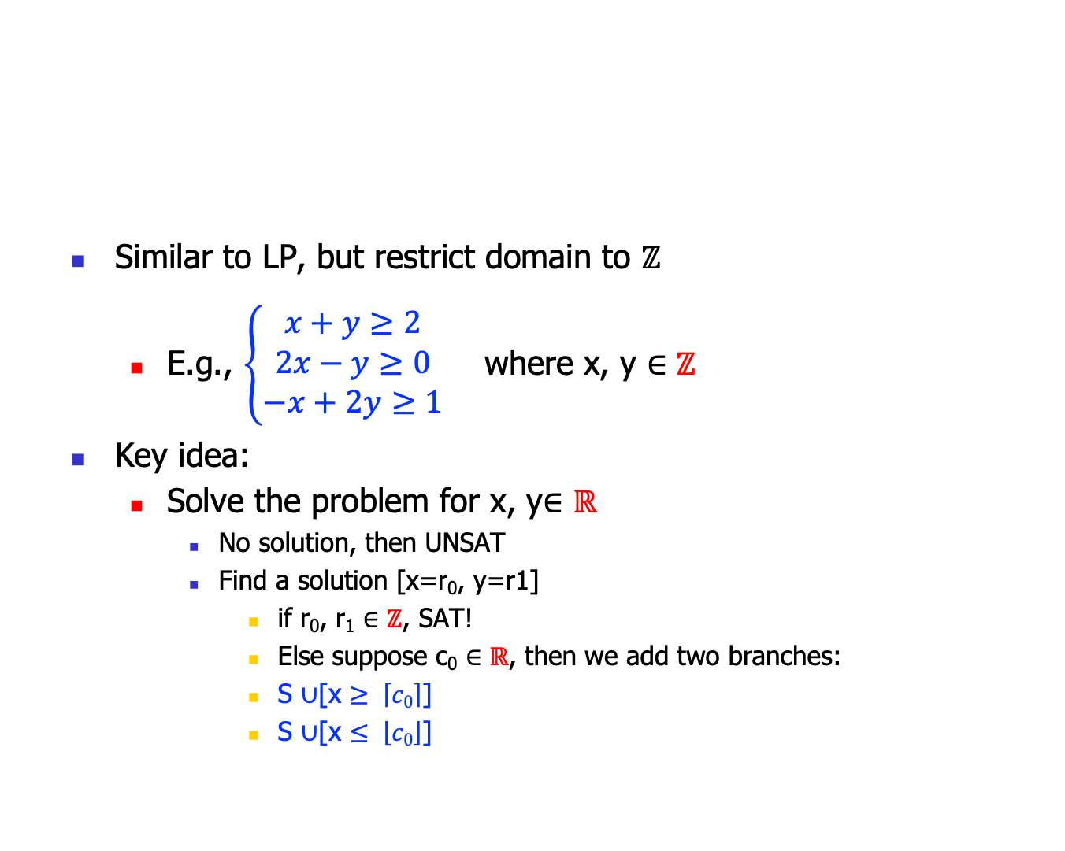
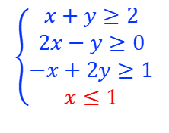
ILP
Suppose:
[x=1.7, y=3.5]
Similar to LP, but restrict domain to $ℤ$
E.g., $\left\{\begin{aligned}x+y≥2 \\ 2x−y≥0 \\ −x+2y≥1\end{aligned}\right.$ where x, y $∈ℤ$
Key idea:
Solve the problem for x, y$∈ℝ$
No solution, then UNSAT
Find a solution [x=r₀, y=r1]
if r₀, r₁ $∈ℤ$, SAT!
Else suppose c₀ $∈ℝ$, then we add two branches:
S $∪$[x $≥ \left\lceil c0\right\rceil$]
S $∪$[x $≤ \left\lfloor c0\right\rfloor$]
$$\left\{\begin{aligned}x+y≥2 \\ 2x−y≥0 \\ −x+2y≥1 \\ x≥2\end{aligned}\right.$$
$$\left\{\begin{aligned}x+y≥2 \\ 2x−y≥0 \\ −x+2y≥1 \\ x≤1\end{aligned}\right.$$

Slide 52

Geometry Intuition
Recall our plane model
We want the integer points in the region
The first solution [x= , …]
Add the vertical line
Divide-conquer
$$∗$$
$$∎$$
$$∎$$
$$∎$$
$$∎$$
$$∎$$
$$∎$$
$$∎$$
$$∎$$
$$∗$$
$$∎$$
$$∎$$
$$∎$$
$$∎$$

Slide 53
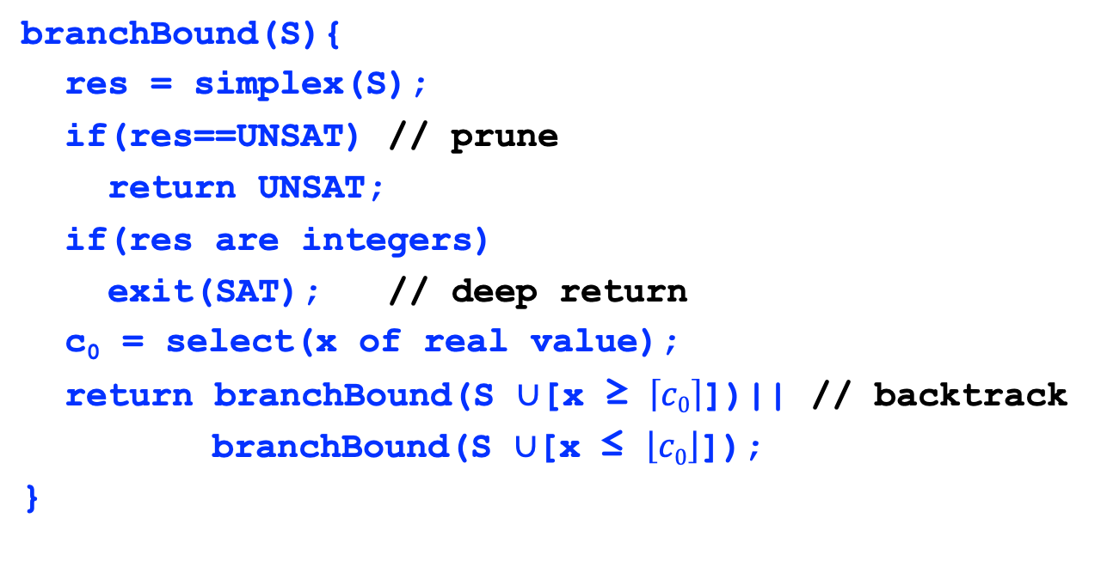
Branch-bound algorithm
branchBound(S){
res = simplex(S);
if(res==UNSAT) // prune
return UNSAT;
if(res are integers)
exit(SAT); // deep return
c₀ = select(x of real value);
return branchBound(S $∪$[x ≥ $\left\lceil c0\right\rceil$])|| // backtrack
branchBound(S $∪$[x ≤ $\left\lfloor c0\right\rfloor$]);
}

Slide 54
Graphically: a decision tree
a=1.3
b=4.5
c=-3.8
a<=1
b=4.5
c=-3.8
a>=2
b=4.5
c=-3.8
a<=1
b<=4
c=-3.8
a<=1
b>=5
c=-3.8

Slide 55
LA/LP Theory Applications

Slide 56
#1: Compiler optimization
foo(int[] A){
for(int i=1; i<10; i++){
A[j+i] = A[j];
}
}
For this to be feasible, we must guarantee that A[j] is a constant. For this example, that is:
j+i=j /\
i>=1 /\
i<10
must be UNSAT!
// Loop invariant hoisting:
foo(int[] A){
int t = A[j];
for(int i=1; i<10; i++){
A[j+i] = t;
}
}

Slide 57
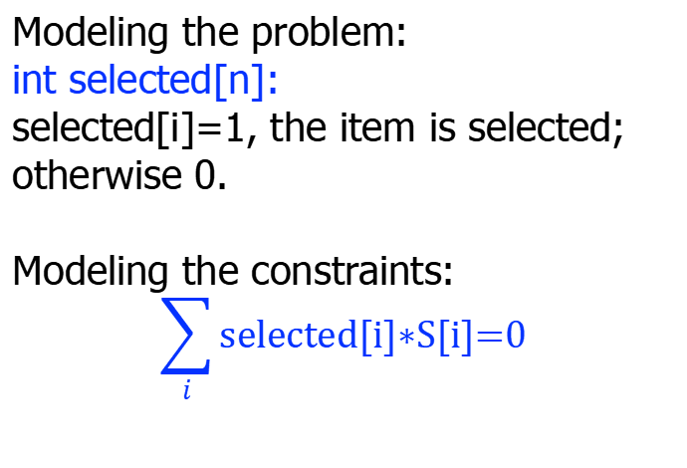
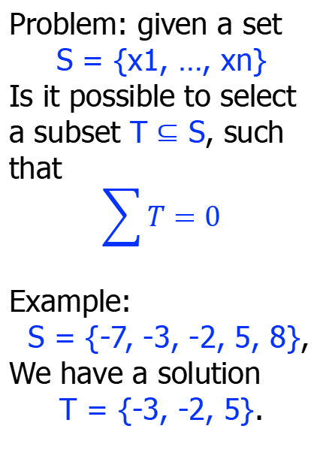
#2: subset sum problem
Modeling the problem:
int selected[n]:
selected[i]=1, the item is selected; otherwise 0.
Modeling the constraints:
$$\sum_{i}{\text{selected}\text{[}\text{i}\text{]}\text{∗}\text{S}\text{[}\text{i}\text{]=0}}$$
Problem: given a set
S = {x1, …, xn}
Is it possible to select a subset T $⊆$ S, such that
$$\sum{T}=0$$
Example:
S = {-7, -3, -2, 5, 8},
We have a solution
T = {-3, -2, 5}.

Slide 58

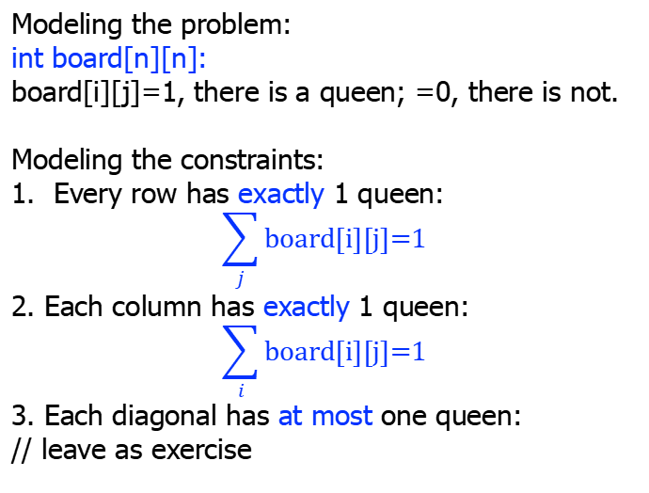
#3: n-queens puzzle
Modeling the problem:
int board[n][n]:
board[i][j]=1, there is a queen; =0, there is not.
Modeling the constraints:
Every row has exactly 1 queen:
$$\sum_{j}{\text{board}\text{[}\text{i}\text{][}\text{j}\text{]=1}}$$
2. Each column has exactly 1 queen:
$$\sum_{i}{\text{board}\text{[}\text{i}\text{][}\text{j}\text{]=1}}$$
3. Each diagonal has at most one queen:
// leave as exercise
Is it possible to put n queens on a n*n board, so that no queen can attack each other?
Not on the same row;
Not on the same column;
Not on the same diagonal.
The above is a 4-queens puzzle.

Slide 59


#4: Sudoku
Fill in a board of numbers, such that each row, each column, and each block comprises the numbers 1-9.
The right figure is a board of 3²*3².
(NPC for the general n).
The recent result demonstrate that
for 3²*3², the
#solutions = 6,670,903,752,021,072,936,960
= 6.671*10²¹
For a board of 4²*4², the #estimated = 10⁹⁸

Slide 60

#4: Sudoku
Modeling the constraints: each board position has a variable b_{i,j} such that
1<= b_{i,j} <= 9
No repeated numbers for each row, column, and block.
E.g., the first row:
b_{0, 0} $≠$ b_{0, 1} b_{0, 2} … b_{0, 8}
b_{0, 1} $≠$b_{0, 2} … b_{0, 8}
b_{0, 2} $≠$… b_{0, 8}

Slide 61

#5: task scheduling
Modeling the problem:
int selected[n]:
selected[i]=1, the task is selected; otherwise 0.
Modeling the constraints:
selected[i]+selected[j]<=1
If task j overlaps with task i.
Goal: max($\sum_{i}{\text{selected}\text{[}\text{i}\text{]}}$)
Problem: given n tasks with start and finish time:
S = {s1, …, sn}
F = {f1, …, fn}
How to arrange them, so that there are maximum number of tasks.
Example:
S={1, 3, 0, 5, 8, 5}
F={2, 4, 6, 7, 9, 9}
Max = 4.

Slide 62

#6: task assignment
Modeling the problem:
int assign[n][n]:
assign[i][j]=1, the task j is assigned to person i; otherwise 0.
Modeling the constraints:
Each row has just one 1;
Each column has just one 1.
Goal: max($\sum_{i,j}{\text{profit}\text{[}\text{i}\text{][}\text{j}\text{]}}$)
Problem: for n persons p1, …, pn and n tasks t1, …, tn, with the specific profit, when person pi does task tj:
How to assign the n tasks to n persons, to maximize the profit.
 | t1 | … | tn
p1 | c11 | … | c1n
…
pn | cn1 | … | cnn

Slide 63

#7: factory
A factory makes 3 products P1, P2, and P3 from 2 ingredients i1 and i2, how to maximize the #value? (i1=100, i2=120)
Constraints:
$$\left\{\begin{aligned}2x+3y+z≤100 \\ 3x+3y+2z≤120 \\ x, y, z≥0\end{aligned}\right.$$
target function:
max(40x+45y+24z)
Product/ Ingredient | P1 | P2 | P3
i1 | 2 | 3 | 1
i2 | 3 | 3 | 2
#value | 40 | 45 | 24

Slide 64

#8: 0-1 knapsack
Modeling the problem:
int selected[n]:
selected[i]=1, the item i is selected; otherwise 0.
Modeling the constraints:
W[i]*selected[i] <= W;
Goal: max($\sum_{i}{\text{V}\text{[}\text{i}\text{]}\text{∗}\text{selected}\text{[}\text{i}}$])
Problem: given n items with weight W and value V:
For a knapsack of maximal weight W, how to select items to maximize V.
 | t1 | … | tn
V | v1 | … | vn
W | w1 | … | wn

Slide 65

Summary
LA solves linear constraints
polynomial for $ℝ$, NPC for $ℤ$
LP minimize or maximize a target function under a set of constaints
Encoding them in SMT is natural and easy
We just write down the constraints, instead of the algorithms
Right tools for the right problems!

